Slide 1

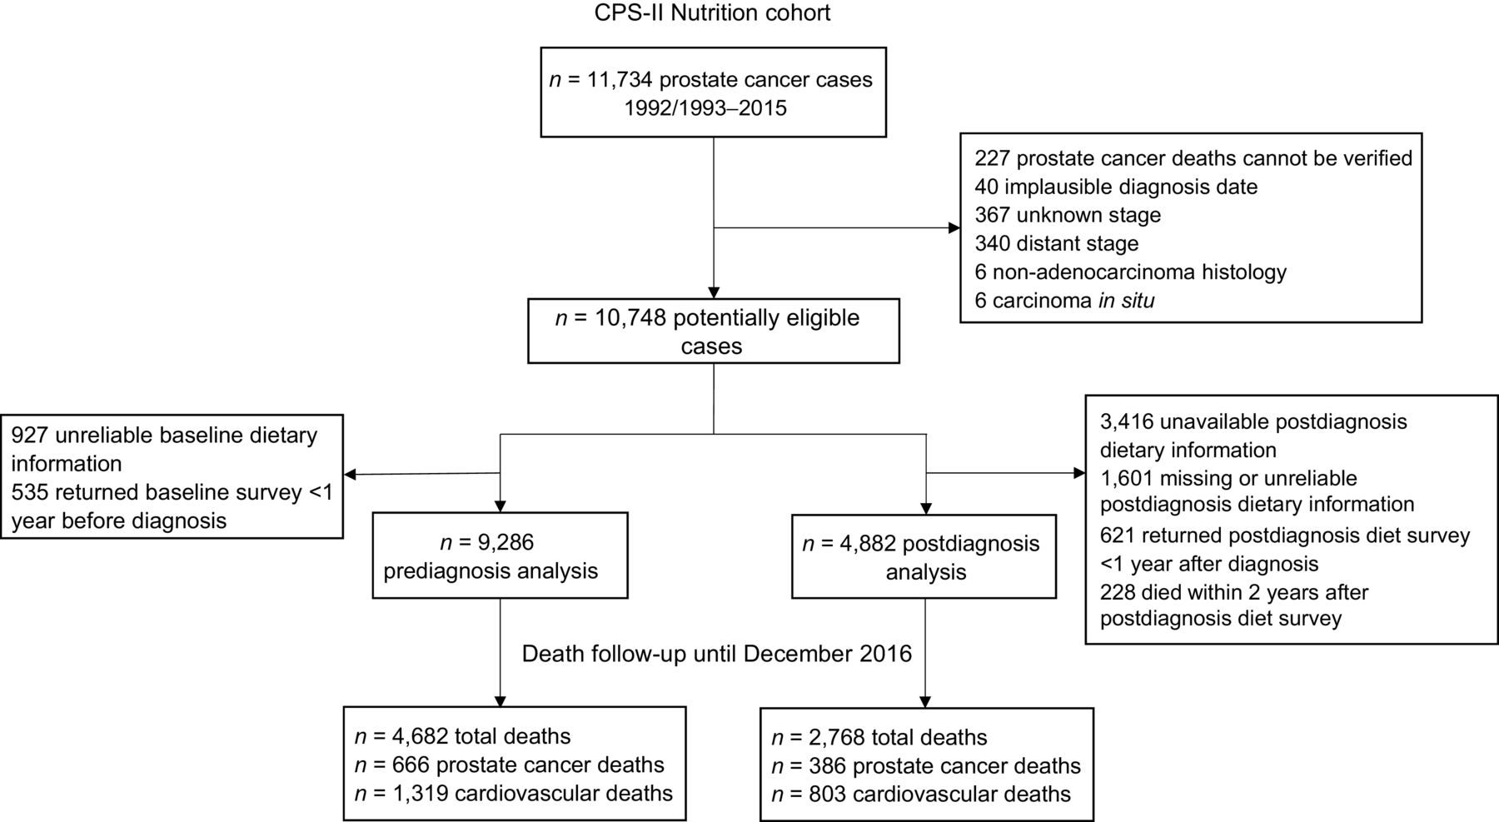
From: Red and Processed Meat, Poultry, Fish, and Egg Intakes and Cause-Specific and All-Cause Mortality among Men with Nonmetastatic Prostate Cancer in a U.S. Cohort
Cancer Epidemiol Biomarkers Prev. 2020;29(5):1029-1038. doi:10.1158/1055-9965.EPI-19-1426
^{Date of Download: 7/19/2024}
Copyright © 2024 American Association for Cancer Research. All rights reserved.
Notes:
Figure Legend:
Prostate cancer cases drawn from the CPS-II Nutrition Cohort 1992/1993–2015, and number of deaths identified up to 2016.

